Slide 1
Fantastic Four at Table Six
Gauging Collectors’ Character; Or,
The Fingerprint or DNA of Collections

Slide 2
Semantic Similarities between MS miscellanies
Research questions
How do these collections reflect their collectors—their interests, preferences, tendencies?
What is the range of profiles of these collectors? And how diverse are these collections (and the collectors they represent)?

Slide 3
Semantic Similarities between MS miscellanies
Conflate heading/title fields and concatenate with first/second/penultimate/last lines
Embedding vector data related to poems content
Compile item data within manuscript collections
Data challenges: limited semantic content; redundancy/repetition; personal names
Compare MS collections for degrees of semantic, topical and thematic similarity
Analyse topical content and sentiment of individual collections
Manifest as visualizations

Slide 4
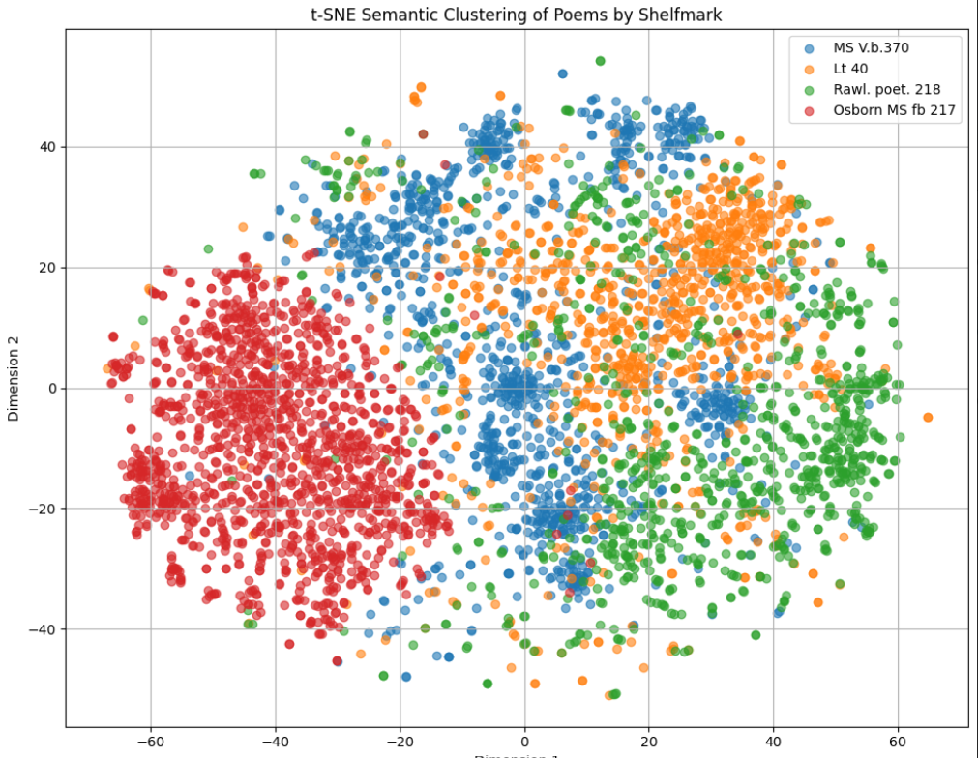
Four largest collections
Oxford Rawl. poet. 218 entirely poems by a non-canonical writer Robert Robinson (fl. 1660).
Folger MS v.b.370 a “miscellany” of anonymous author(s)
Leeds University Library Lt.40 entirely poems by noncanonical writer Sir Philip Wodehouse
Yale Osborn MS fb 217
Ten books of epigrams.

Slide 5
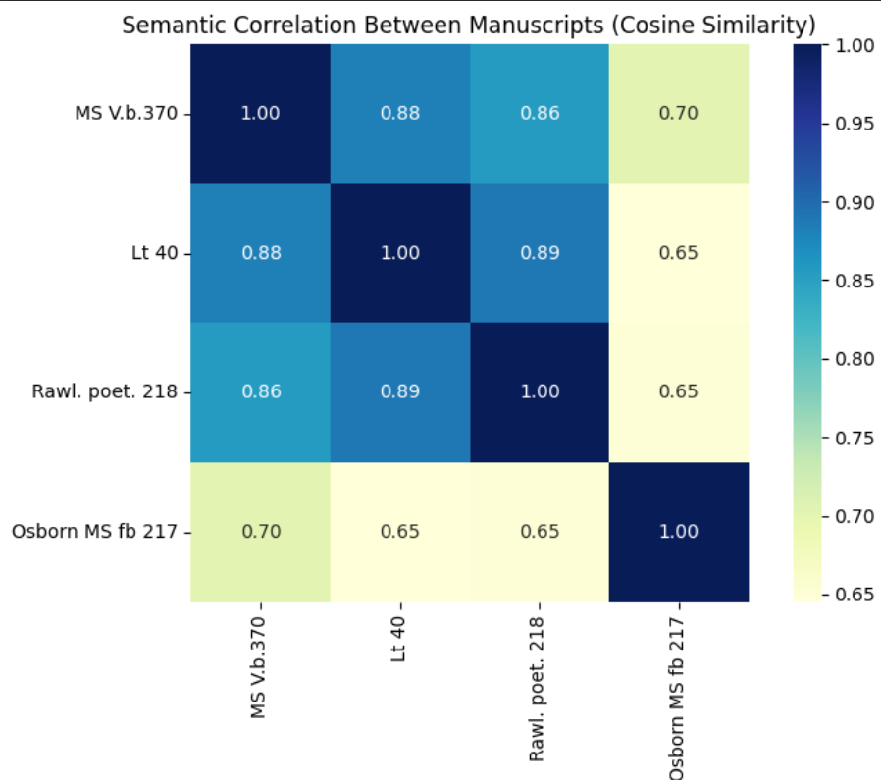
Four largest collections
Oxford Rawl. poet. 218 entirely poems by a non-canonical writer Robert Robinson (fl. 1660)
Folger MS v.b.370 a “miscellany” of anonymous author(s)
Leeds University LibraryLt.40 entirely poems by noncanonical writer Sir Philip Wodehouse
Yale Osborn MS fb 217
Ten books of epigrams

Slide 6
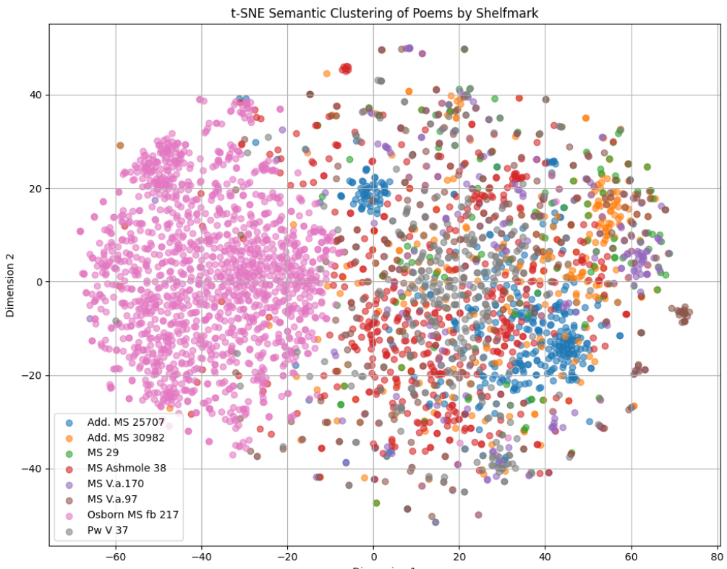
Miscellanies (plus MS fb 217)
Aberdeen University Library, MS 29
British Library, Add. MS 25707
British Library, Add. MS 30982
Bodleian, MS Ashmole 38
Folger, MS V.a.170
Folger, MS V.a.97
University of Nottingham, Pw V 37
Yale Osborn MS fb 217

Slide 7
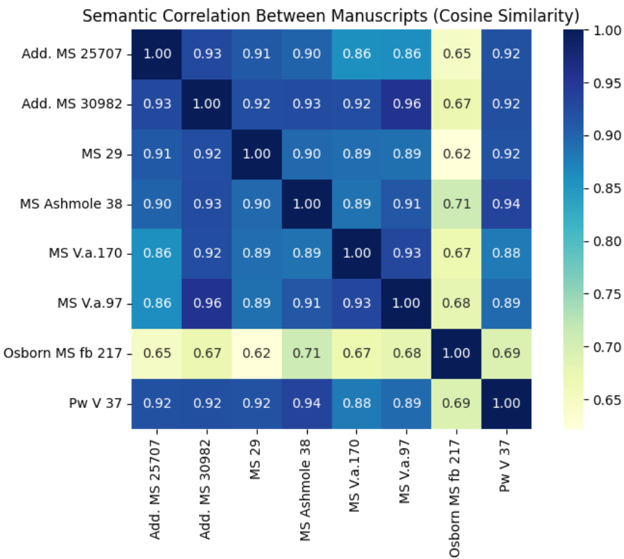
Miscellanies (plus MS fb 217)
Aberdeen University Library, MS 29
British Library, Add. MS 25707
British Library, Add. MS 30982
Bodleian, MS Ashmole 38
Folger, MS V.a.170
Folger, MS V.a.97
University of Nottingham, Pw V 37
Yale Osborn MS fb 217

Slide 8
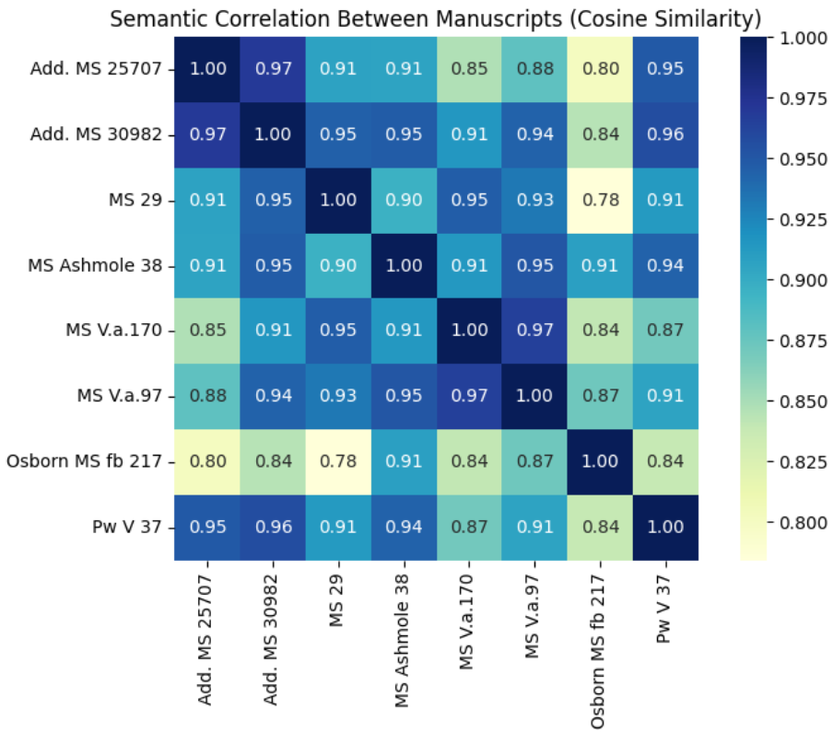
Miscellanies (plus MS fb 217)
Aberdeen University Library, MS 29
British Library, Add. MS 25707
British Library, Add. MS 30982
Bodleian, MS Ashmole 38
Folger, MS V.a.170
Folger, MS V.a.97
University of Nottingham, Pw V 37
Yale Osborn MS fb 217
Heading removed

Slide 9
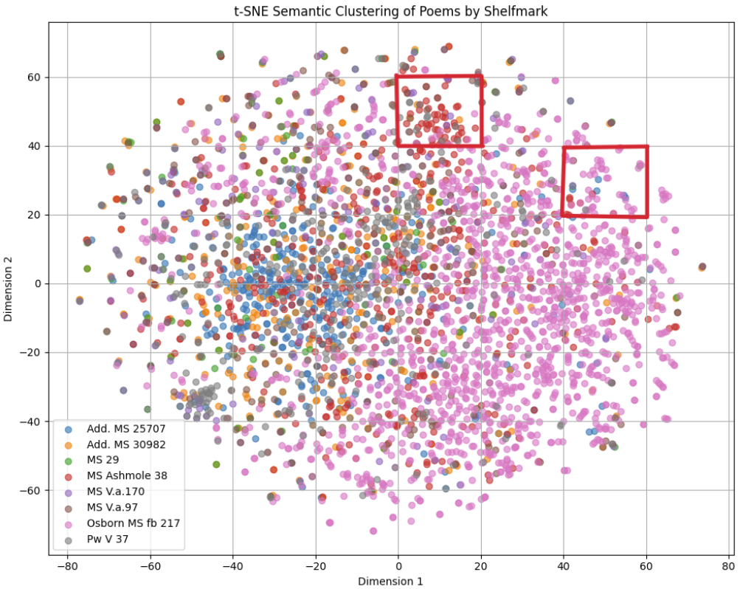
Miscellanies (plus MS fb 217)
Aberdeen University Library, MS 29
British Library, Add. MS 25707
British Library, Add. MS 30982
Bodleian, MS Ashmole 38
Folger, MS V.a.170
Folger, MS V.a.97
University of Nottingham, Pw V 37
Yale Osborn MS fb 217
Analyzing Clusters
Heading removed
Life & Death
Friendship & Brotherhood

Slide 10
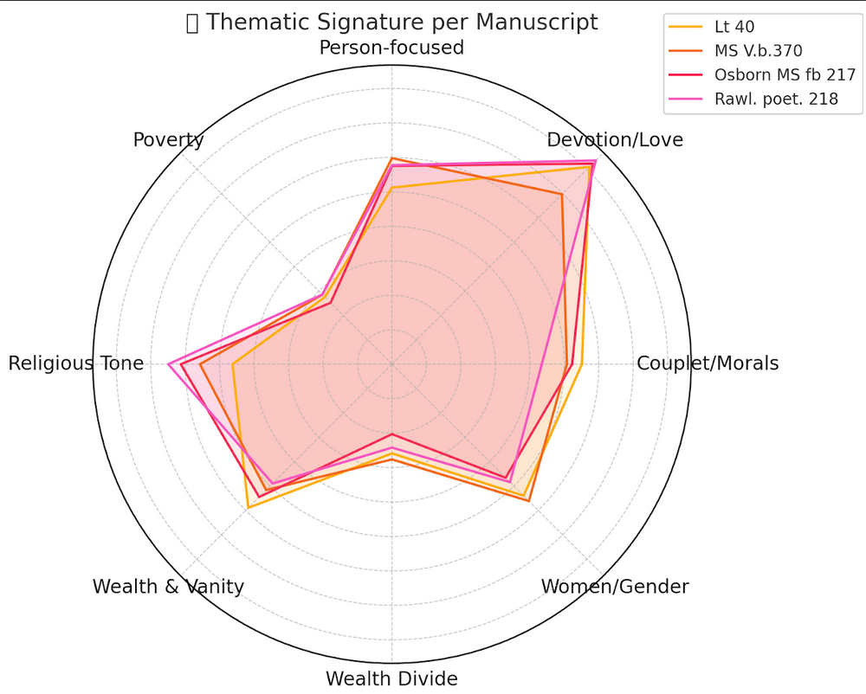
Thematic Analysis
Filtered data with stop words and asked ChatGPT to generate themes based on all the data in STEMMA
ChatGPT does not understand metaphor

Slide 11
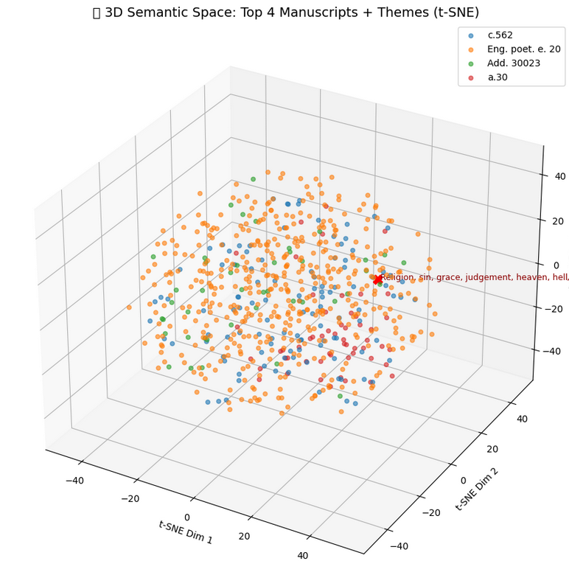
Thematic Analysis
Defined our own theme of “religion and religious” with terms: sin, grace, judgement, heaven, hell, death, resurrection, salvation

Slide 12
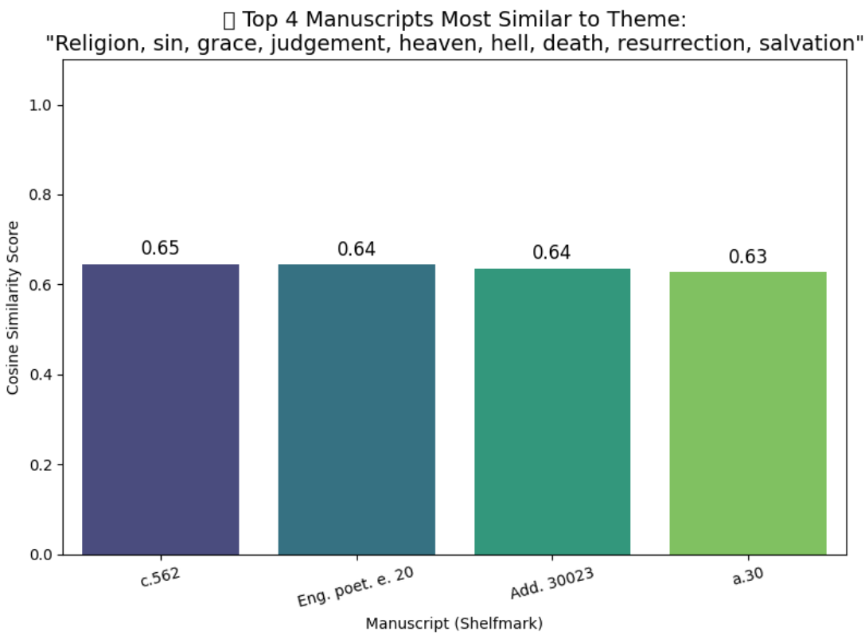
Thematic Analysis
Where might George Herbert’s MS Tanner 307 score?
Lots of John Donne
Gervase Disney 18th c.

Slide 13
What we learned
ChatGPT doesn’t understand early modern poetry.
Personal names messed up our results: vectored data did not accommodate. Needed to do some data preparation or add as stop-words.
Visualizations are nice but reductive: cosine similarity more accurate and representative
Vectored data;
  Results improved when we removed heading field (which included personal names)
  number of items in ms does not skew data, but number line (one to four) skews data
  Lemmatization automatically eliminated most stopwords
Future scope: very flexible model
  Strong model for distant reading
  Semantic analysis: diversity between manuscripts in similarity
  Thematic analysis: apply more themes to generate DNA signatures of mss

